Slide 1
How could the next Common Agricultural Policy be shaped?
Expert-based evaluation of future scenarios
Linn N. Schaan¹²³, Elizabeth A. Finch¹², Guy Pe’er¹², Greta S. Theilen⁴, Julian Rode¹, Francisco Moreira ⁵
1. Helmholtz Centre for Environmental Research - UFZ, Leipzig, Germany
2. German Centre for integrative Biodiversity Research (iDiv) Halle-Jena-Leipzig, Germany
3. Faculty of Life Science, Humboldt University of Berlin, Berlin, Germany
4. University of Rostock, Rostock, Germany
5. Research Center in Biodiversity and Genetic Resources, Universidade do Porto, Porto, Portugal

Slide 2
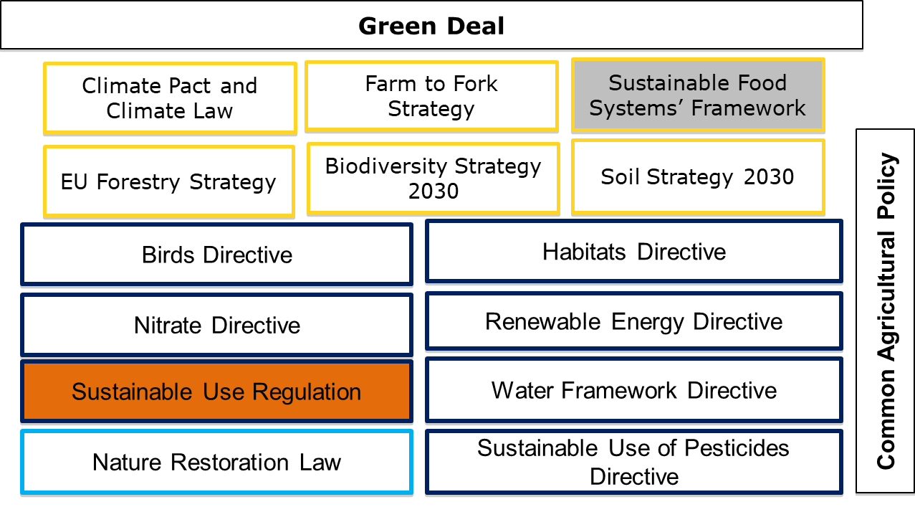
Key elements in the EU policy toolkit for agroecology
EU strategies (high level sectoral plans)
EU directives (different implementation but same goal)
EU law (binding legislative act)
pending
rejected

Slide 3
Research questions
Material & methods
Developed of future CAP scenarios based on a systematic literature review
Which future CAP scenarios can be identified from the scientific literature?
EU-wide survey dissemination to CAP experts with various backgrounds (i.e., research focus, stakeholder group)
How to expert evaluate these future CAP scenarios in terms of their strengths, weaknesses and feasibility? What are the barriers?
What overall barriers and potential solutions can be identified in the context of CAP reform?
Broad expert understanding including scientists and experts outside academia
Which CAP scenarios support Agroecology, and how do they balance the prioritisation of environmental, social and economic agroecological principles?
Inductive qualitative coding of survey responses

Slide 4
Identify future key scenarios for the Common Agricultural Policy
Scenario 1
Continuation of the
current CAP
Scenario 2
Strengthening green
and social architecture
Scenario 3
Food system policy
Scenario 4
Substantial reduction
of CAP budget

Slide 5
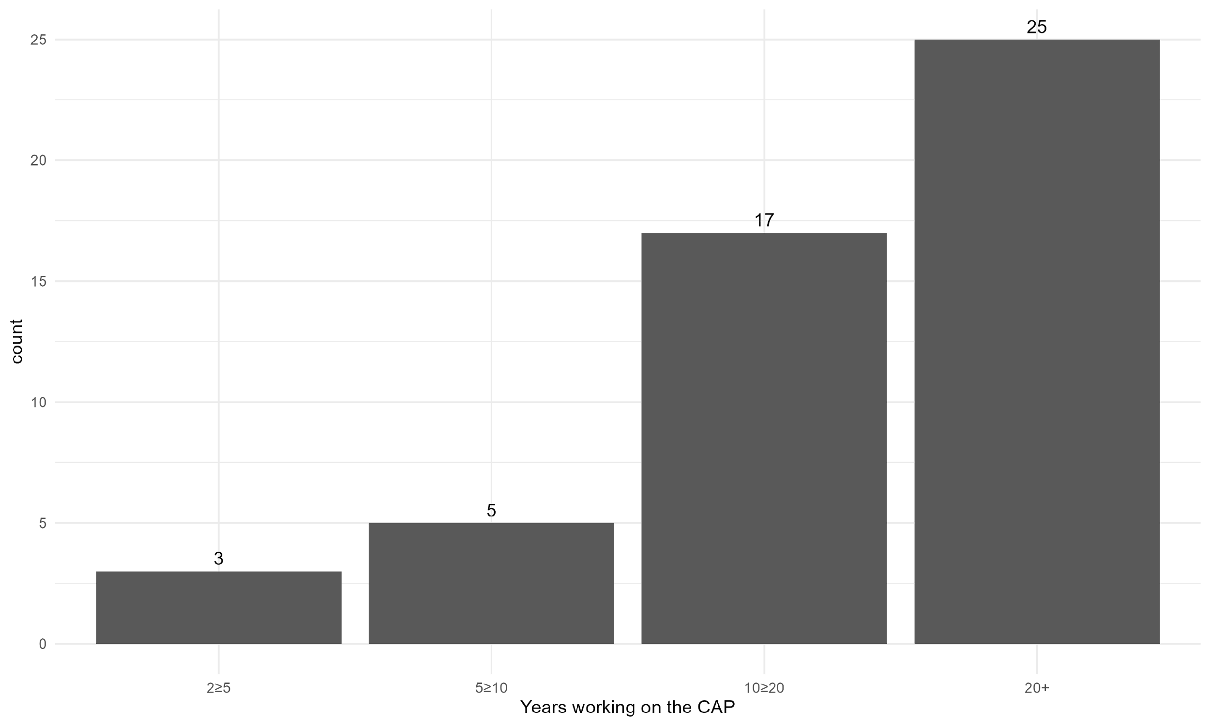
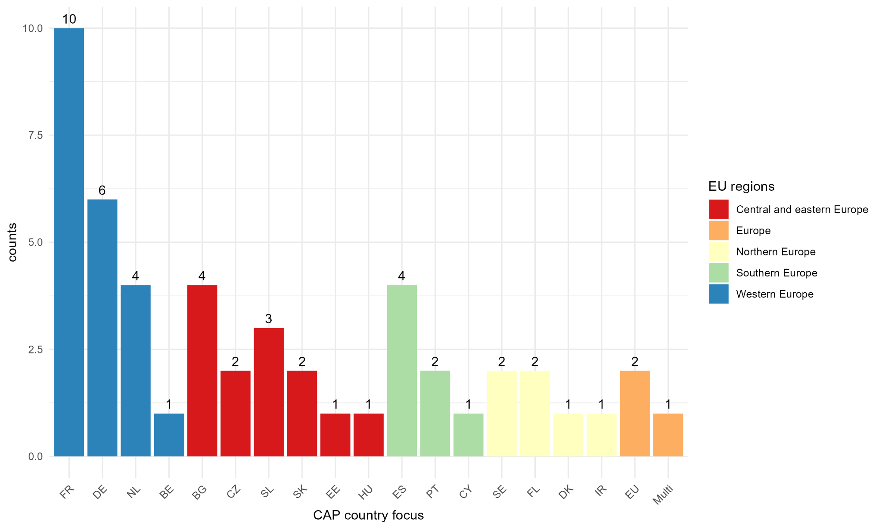
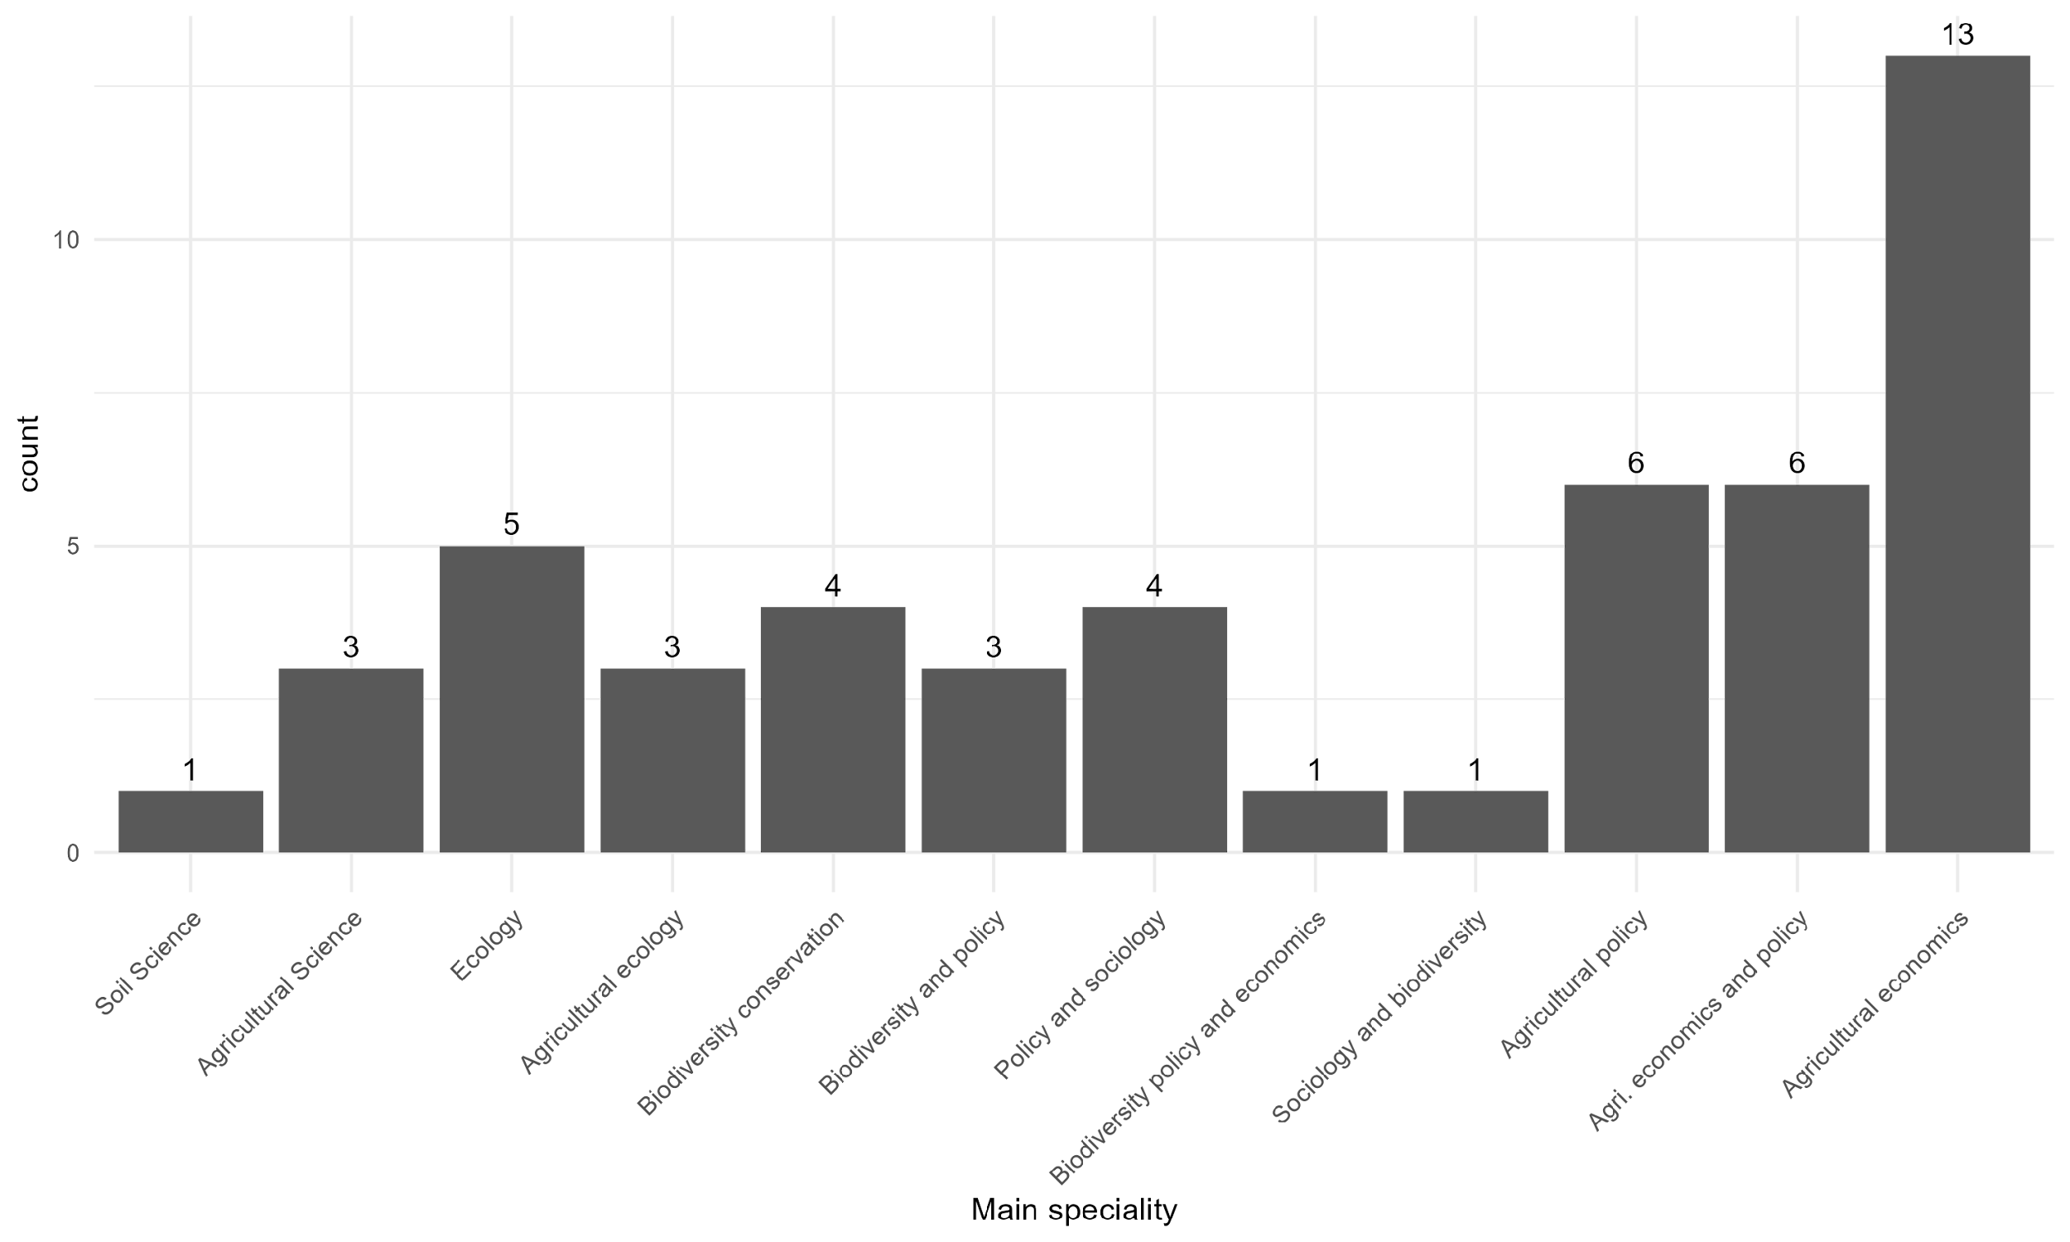
Overview of respondents (scientists)
n = 50

Slide 6
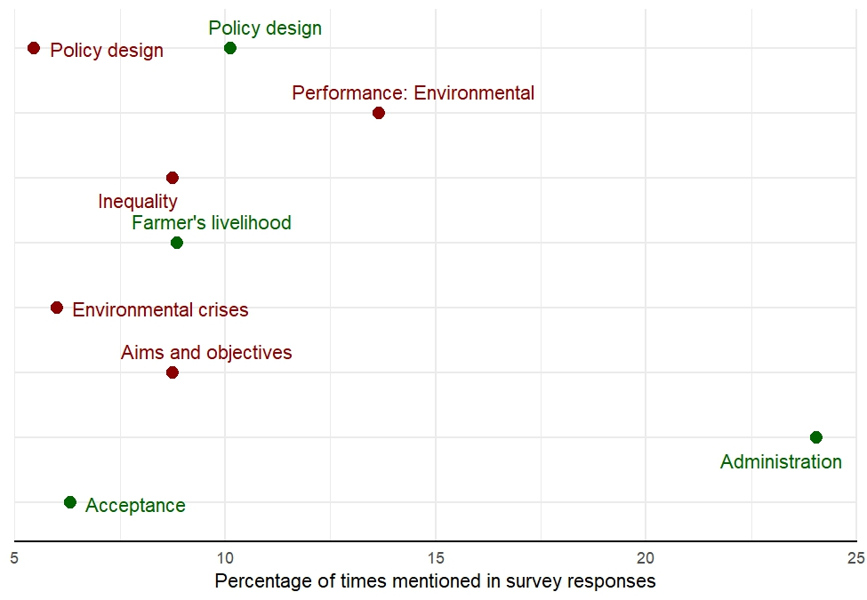
Scenario 1: Strengths and Weaknesses
Scenario 1
Continuation of the
current CAP (BAU)
Stability & predictability
administratively simple
strong acceptance & low political resistance
stability of payment systems
Low env. and social performance
lack of env. and social performance and ambition
ineffective and less flexible policy design

Slide 7
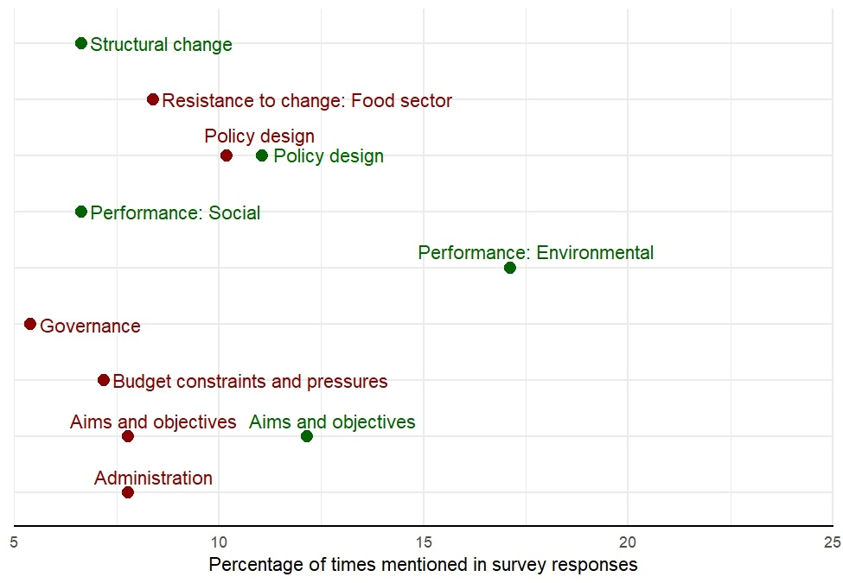
Scenario 2: Strengths and Weaknesses
Scenario 2
Strengthening green
and social architecture
Improved socio-env. performance
increased focus on env. and social objectives;
improved env. and social performance
regionalization and familiar system
High transaction costs for transition
too complex, too inflexible, too costly
resistance by actors dependent on subsidies

Slide 8
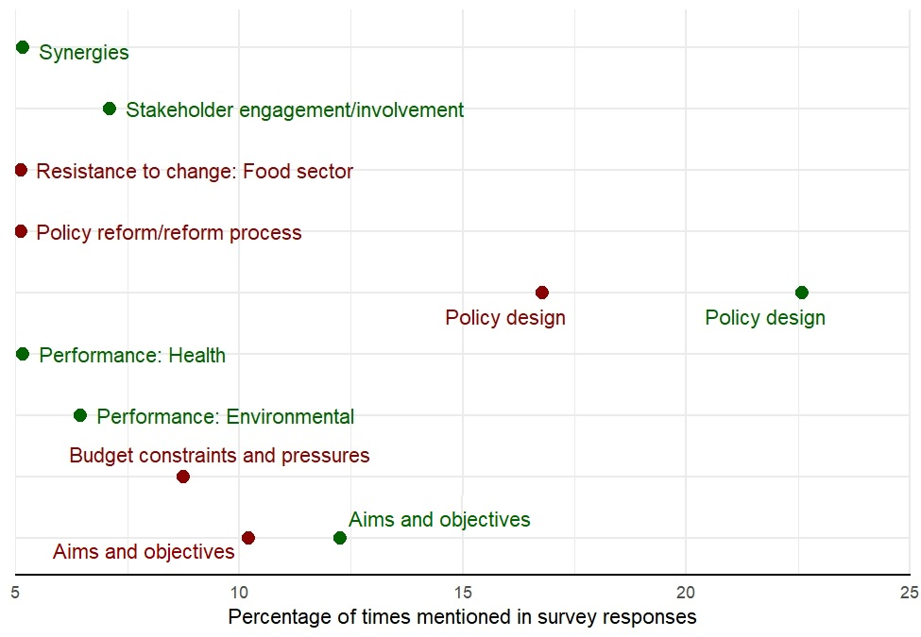
Scenario 3: Strengths and Weaknesses
Scenario 3
Food system policy
Address challenges along the value chain
increased comprehensivity and integration of supply and demand side
Promotion of synergies
Complex, expensive and may generate risks
complex and maybe too new
Not ambitious enough
large budget increase is unlikely

Slide 9
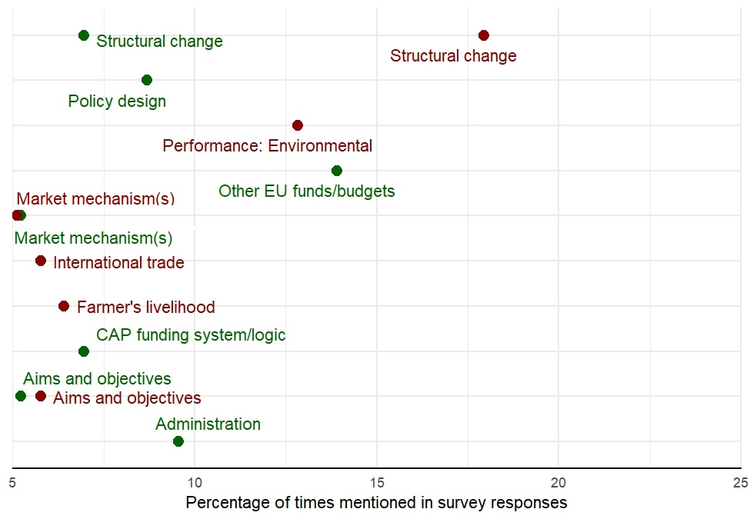
Scenario 4: Strengths and Weaknesses
Save money and allow changes
frees up budget for other policies
simplifies administration and reduces burden
Agri-sector treated like every other economic sector
Scenario 4
Substantial reduction
of CAP budget
May worsen existing challenges of the farming sector and rural areas
rapid structural change (land abandonment, loss of small farmers)
decreased env. performance
lack of public good provision

Slide 10
Consideration of Agroecology in future CAP scenarios
 | Environmental principles
 | Improve resource efficiency (including recycling and input reduction) | Strengthen resilience (including soil health, animal health, biodiversity, synergy)
Scenario 1: Continuation of the current CAP (BAU) |  | -
Scenario 2: Strengthening green and social architecture |  | +
Scenario 3: Food system policy |  | +/-
Scenario 4: Substantial reduction of CAP budget |  | -
+ | support
+/- | mixed support
- | no support
 | not applicable
Food transition: Level 1 - 3 transformation on agroecosystem level

Slide 11
Consideration of Agroecology in future CAP scenarios
 | Socio-economic principle: Secure social equity/responsibility
 | Economic diversification | Co-creation of knowledge | Social values and diets | Fairness | Connectivity | Natural resource governance | Participation
Scenario 1: Continuation of the current CAP (BAU) | - | ? | - | - | - | +/-
Scenario 2: Strengthening green and social architecture | + |  | +/- | + |  | +
Scenario 3: Food system policy | +/- | + | + | +/- | ? | + | +
Scenario 4: Substantial reduction of CAP budget | +/- |  | - | - |  | -
Food transition: Level 1 - 3 transformation on agroecosystem level
+ | support
+/- | mixed support
- | no support
? | to be discussed
 | not applicable
Food transition: Level 4 & 5 transformation on food system levels

Slide 12
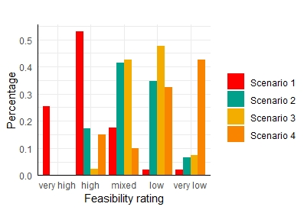
Respondents results: feasibility rating
Scenario 1
Continuation of the
current CAP
Scenario 2
Strengthening green and
social architecture
Scenario 3
Food system policy
Scenario 4
Substantial reduction of
CAP budget

Slide 13
Conclusion
Scenario 1 (BAU) assessed as most feasible, few links to AE principles
Scenario 2 (green & social) & 3 (Food system) are better aligned with socio-economic principles of Agroecology but are considered much less feasible overall
Scenario 3 may best support a food system transition for AE but very complex
Scenario 2 could enhance environmental AE principles more but comes with a high administrative burden
Outlook
Research work
Finalise qualitative analysis for all survey respondents (including non-scientists)
A follow up assessment of CAP performance (based on National Strategic Plans): 2nd expert survey
EU Policy context
Prospect (Agroecology ideals versus reality): EU elections could entail high chance for BAU, however leaked plans suggest the merging of CAP with Regional Development Fund, Cohesion and Fisheries with funds allocated based on MS national plans.

Slide 14
Linn N. Schaan
Elizabeth A. Finch
Thank you for you attention!

