Slide 1
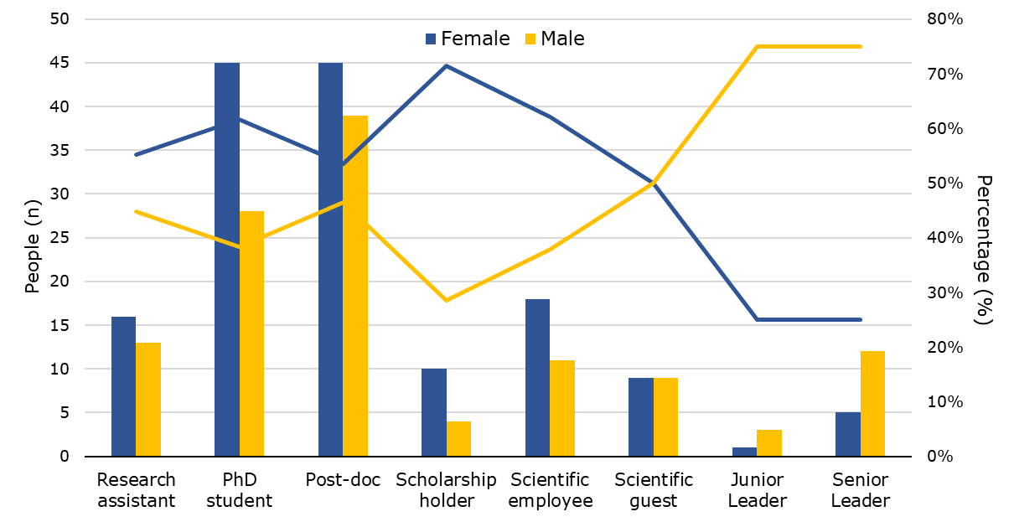
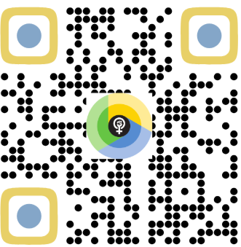
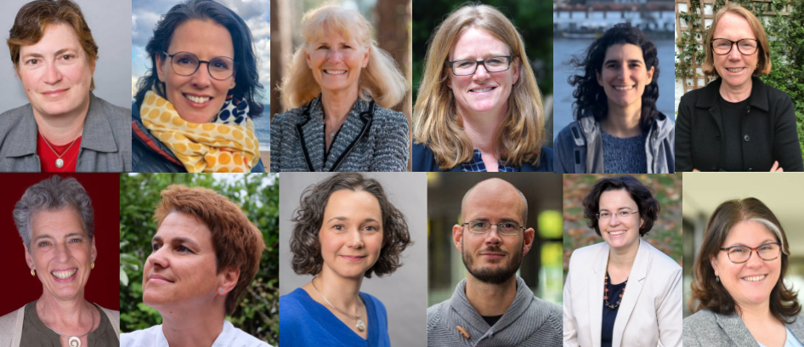
Empowering Women
in Science
Reflect
Develop
Inspire
Expand
scan to
Connect
Notes:
1) Connect: build a supportive network
2) Develop: advance technical skills
3) Reflect: enhance transparency and awareness
4) Inspire: host speakers and discussions
5) Expand: connect beyond iDiv

