Slide 1
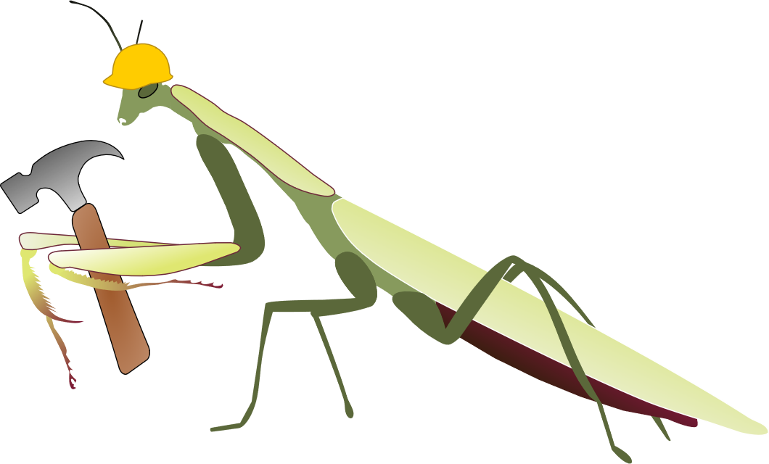
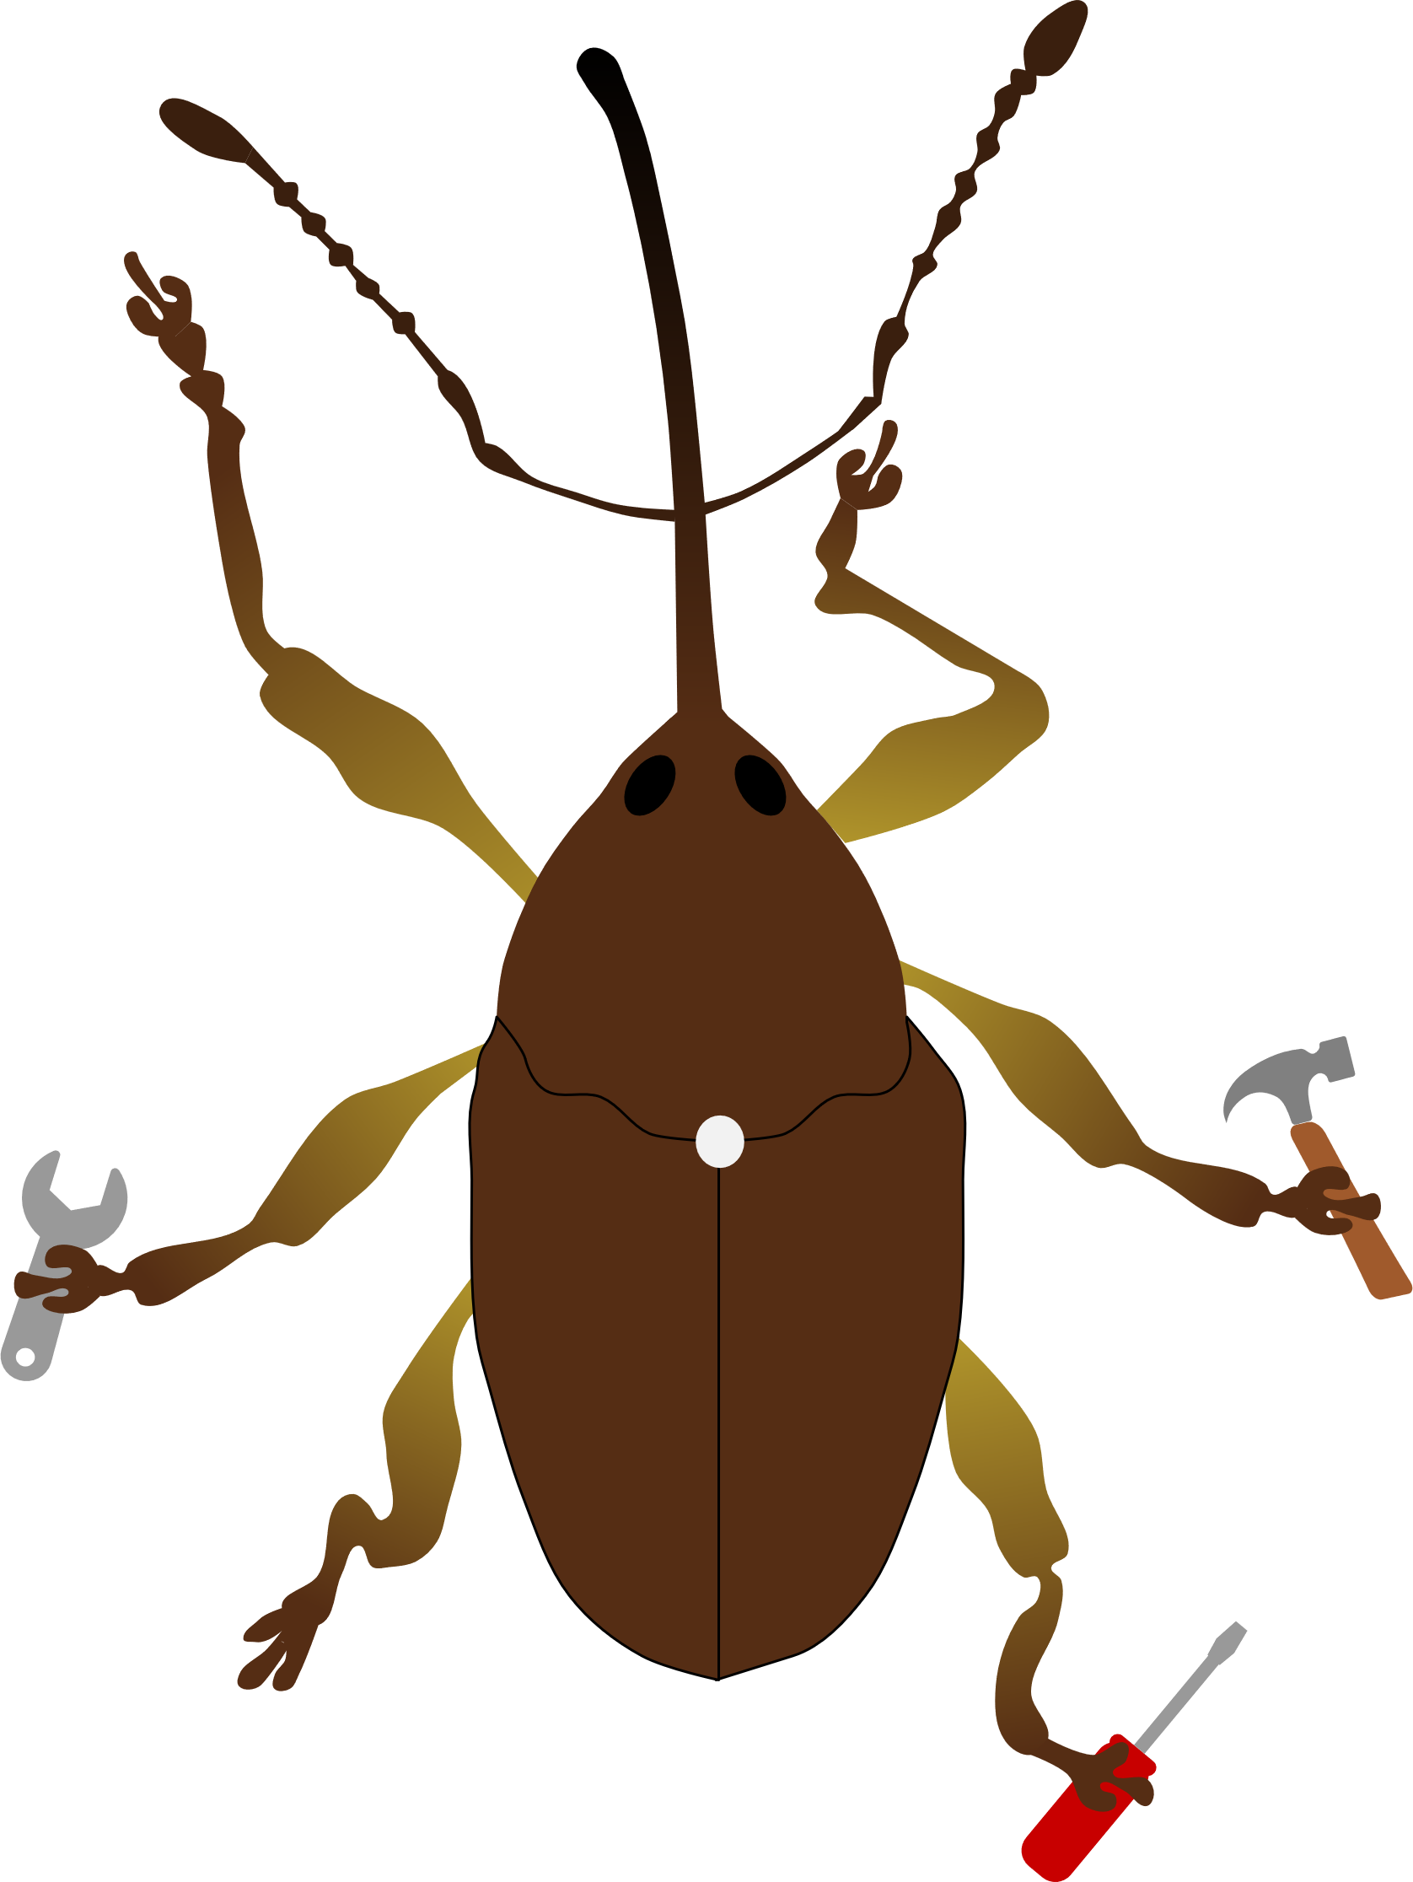
Emily Dovydaitis, Michael Gerth, Chloé Schmidt
Genetic diversity helps us understand biodiversity
Construct a database:
microsatellites
(nuclear, neutral DNA )
Does genetic diversity covary…
With human influence?
Climate? Latitude?

